Slide 1
Resilience and Reliability in PJM’s Competitive Markets
Stu Bresler
SVP - Operations & Markets
PJM Interconnection, LLC

Slide 2
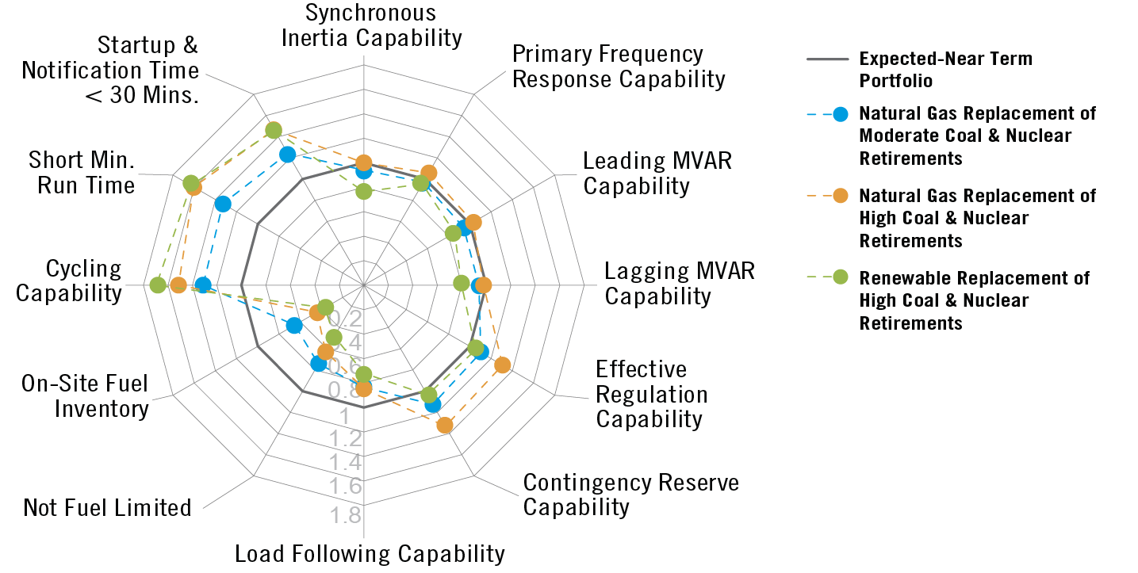
Generator Reliability Attributes in Changing Portfolios – Individual Reliability Attribute Ratios

Slide 3
Natural Gas Generation by Region
FUEL TYPE | ERCOT | FRCC | ISO-NE | MISO | NYISO | PEAK | PJM | SOCO | SPP | TVA | VACAR-S
Coal | 24% | 16% | 6% | 37% | 5% | 14% | 33% | 28% | 33% | 37% | 30%
Hydro | 1% | 0% | 10% | 2% | 14% | 25% | 4% | 9% | 6% | 12% | 9%
Natural Gas | 66% | 65% | 43% | 39% | 55% | 40% | 35% | 49% | 39% | 38% | 34%
Nuclear | 6% | 6% | 11% | 7% | 12% | 3% | 18% | 8% | 3% | 12% | 22%
Wind | 2% | 0% | 3% | 8% | 4% | 9% | 4% | 0% | 15% | 1% | 0%
Oil | 0% | 11% | 21% | 3% | 9% | 0% | 4% | 2% | 2% | 0% | 2%
Solar | 1% | 0% | 1% | 0% | 0% | 4% | 1% | 0% | 0% | 0% | 2%

Slide 4
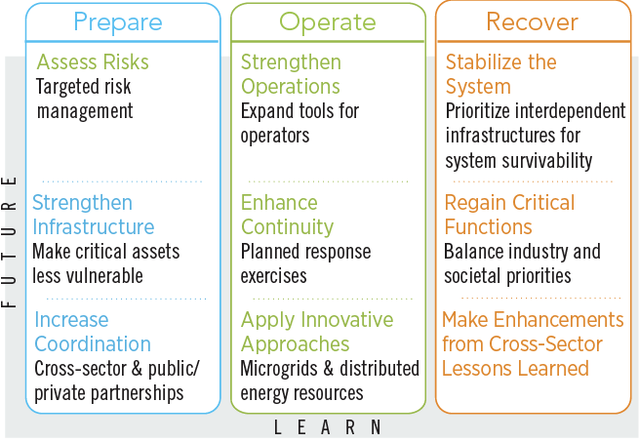
Prepare + Operate + Recover = Resilience

Slide 5
ISO-NE
ERCOT
PJM
CAISO
NYISO
SPP
MISO
Notes:
The proposed rule applies to:
Every RTO that has energy and capacity markets;
Electric generation resource located within an RTO; and that has a 90-day fuel supply on site;
Not subject to cost of service regulation;
It is clear from the DOE NOPR that the target is coal and nuclear generation.
Each RTO must:
Purchase electricity from such resource; and
Provide for recovery of costs and a return of and on equity.
Not ERCOT, not CAISO, not SPP
MISO not clear – questionable if it has a “capacity market”; significant amount of generation is cost of service.
NYISO – has ZECs for nukes; no coal left.
ISONE – nukes are profitable; no coal left.

Slide 6
DOE NOPR Summary
Positives
Focused on reliability and resilience
Recognizes unique attributes of resources
Recognizes current market limitations
Negatives
No clear problem statement
Misuses industry facts including PJM’s Polar Vortex Report
Undermines benefits of competitive markets

Slide 7
High Level PJM Response
Problem to Resolve: Not all resources are being appropriately compensated for the reliability value they are providing
PJM agrees with goals of reliability and resilience
Market solutions are best
Notes:
#3 PJM agrees with some and disagrees with some points in the DOE report – We have a better way!

Slide 8
Proposed Price Formation Enhancements
1
2
Utilize a separate pricing run of the Dispatch software to calculate LMPs
Enhance the price calculation to better reflect the actual cost of serving load
3
4
Explicitly compensate resources for following dispatch
Enhance shortage pricing
Notes:
Improved Incentives
Would correct incentive pitfalls of current model
Improve performance incentives, especially during tight system conditions
Values all resources needed to serve load
Flexible resources can compete for infra-marginal rents
Incentivizes flexibility
Current method promotes inflexible bidding

Slide 9
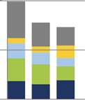
Benefits of Price Formation Enhancements
Uplift Reduction
Include more operator actions in LMP
Reduce revenue shifts caused by uplift
Improved Incentives:
Correct incentive pitfalls of current model
Value all resources needed to serve load
Induce competition for flexibility
Improve performance incentives, especially during tight system conditions

